Slide 1
Functions in EXCEL
TEXT FUNCTIONS

Slide 2
Text functions
Many functions are used to manipulate text values.
The following are only some of them
right( ) left( ) mid( ) concatenate( ) lower( ) upper( ) len( )

Slide 3
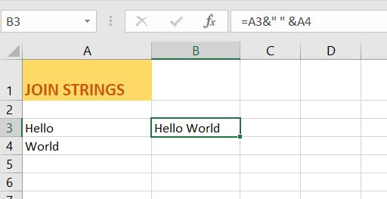
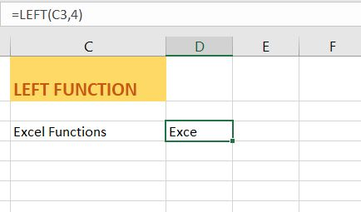
TEXT Functions
JOIN STRINGS
LEFT FUNCTION
To join strings, use the & operator.
To extract the leftmost characters from a string, use the LEFT function.

Slide 4
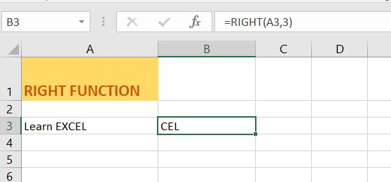
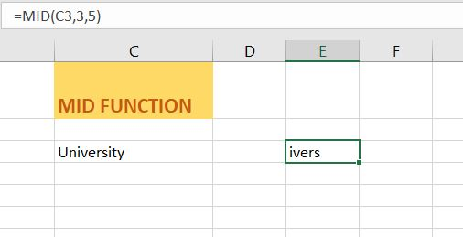
TEXT FUNCTIONS
RIGHT FUNCTION
MID FUNCTION
To extract the rightmost characters from a string, use the RIGHT function.
To extract a substring, starting in the middle of a string, use the MID function.

Slide 5
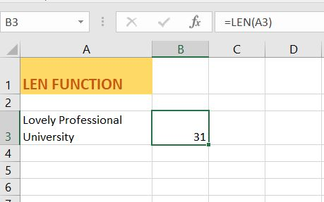
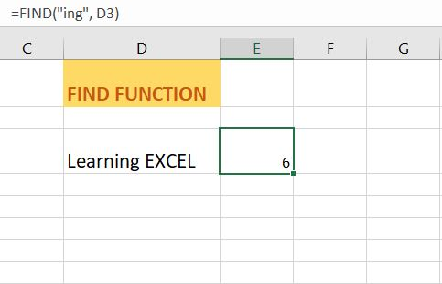
TEXT FUNCTIONS
LEN FUNCTION
FIND
To get the length of a string, use the LEN function.
To find the position of a substring in a string, use the FIND function.

Slide 6
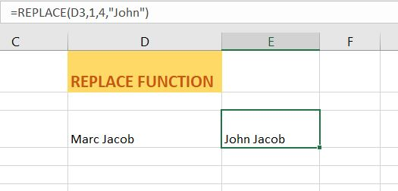
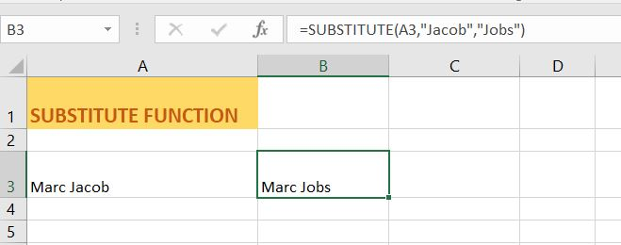
TEXT FUNCTIONS
SUBSTITUTE FUNCTION
REPLACE FUNCTION
To replace existing text with new text in a string, use the SUBSTITUTE function.
If you know the text to be replaced, use the SUBSTITUTE function.
If you know the position of the text to be replaced, use the REPLACE function.

Slide 7
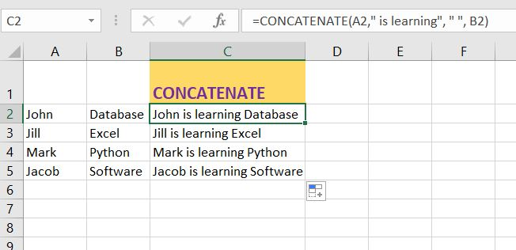
TEXT FUNCTIONs
CONCATENATE FUNCTION
To concatenate or join various strings, simply use concatenate function.

Slide 8
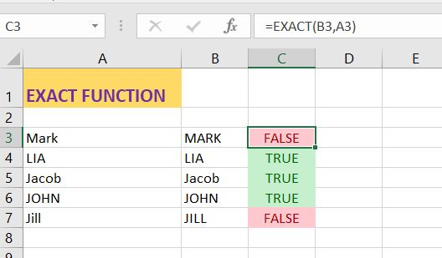
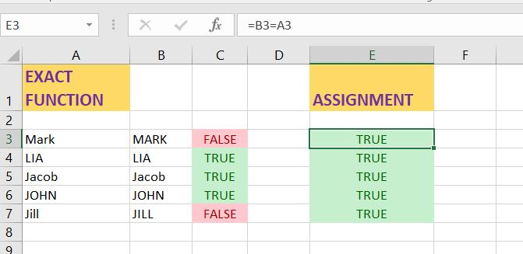
Compare TEXT
EXACT FUNCTION (Case sensitive )
=A=B formula (Case Insensitive)

Slide 9

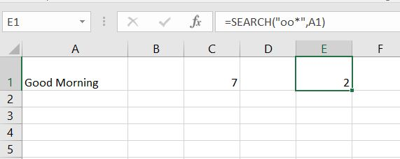
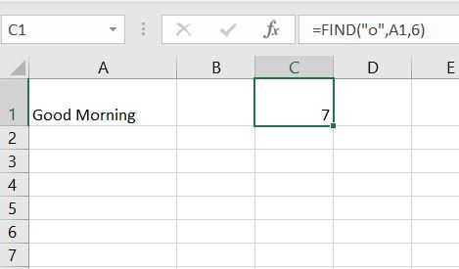
FIND VS. SEARCH FUNCTION
To find the position of a substring in a string, use the FIND function. FIND is case-sensitive.
To find the position of a substring in a string, use the SEARCH function. SEARCH is case-insensitive.
The SEARCH function is more versatile. You can use wildcard characters when you use this function.
One other interesting point to mention about the FIND and the SEARCH function is that they have a 3rd optional argument. You can use this argument to indicate the position, counting from the left, at which you want to start searching.
The search will start from 6th position that is M and will give result of “o” in Morning. If you don’t specify 6, then you will get 2 that is position of “o” in Good

Slide 10
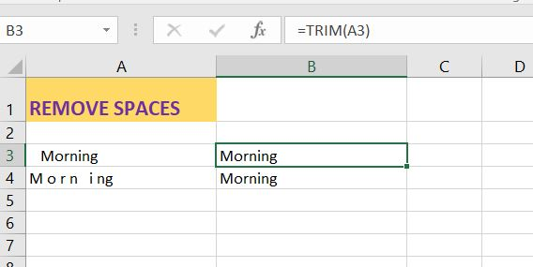
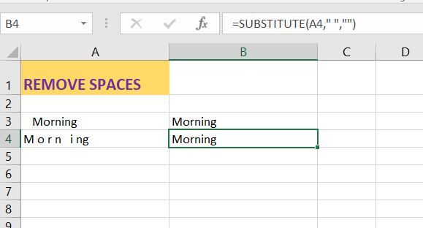
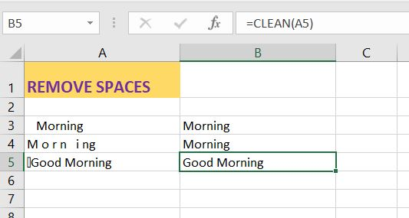
REMOVE EXTRA SPACES
The TRIM function in Excel removes leading spaces, extra spaces and trailing spaces.
Use the SUBSTITUTE function to remove all spaces or non-breaking spaces.
The CLEAN function below removes a non-printable character, CHAR(7).
Simply combine the CLEAN and the TRIM function to remove non-printable characters and spaces.

Slide 11
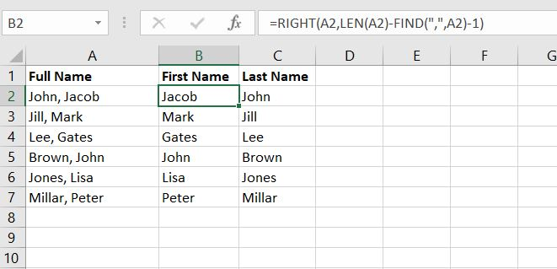
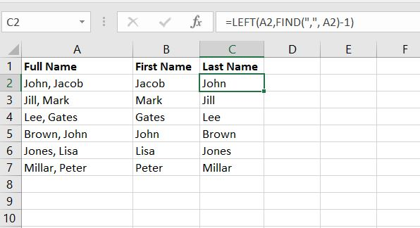
Separate Strings
You have a list of Full Names separated with commas and you want to find first and last name.
To Get the FIRST NAME
To find the position of the comma, use the FIND function (position 5). To get the length of a string, use the LEN function (11 characters). =RIGHT(A2,LEN(A2)-FIND(",",A2)-1) reduces to =RIGHT(A2,11-5-1). =RIGHT(A2,5) extracts the 5 rightmost characters and gives the desired result (Jacob).
To GET the LAST NAME
to find the position of the comma, use the FIND function (position 5). =LEFT(A2,FIND(",", A2)-1) reduces to =LEFT(A2,5-1). =LEFT(A2,4) extracts the 5 leftmost characters and gives the desired result (John).

Slide 12
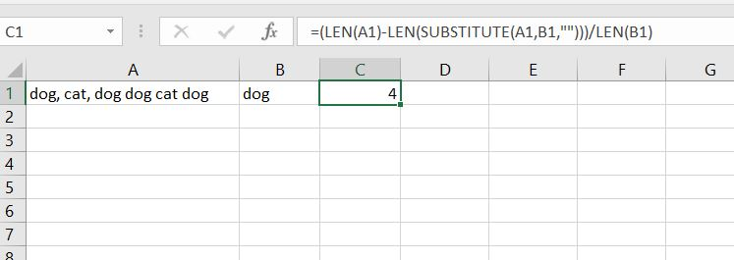
number Of Instances
The SUBSTITUTE function replaces existing text with new text in a string. LEN(SUBSTITUTE(A1,B1,"")) equals 13 (the length of the string without the words dog). If we subtract this number from 25, we get the length of the dog instances (25-13=12).
Use the LEN function to get the length of the string (25 characters, including spaces).
Dividing this number by the length of the word dog (3), gives us the dog instances (12/3=4).

Slide 13
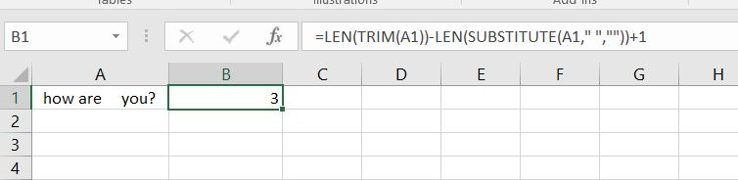
NUMBER OF WORDS
Task : To calculate number of words.
To get the length of the string with normal spaces, we combine the LEN and TRIM function.
LEN(TRIM(A1)= 12
The SUBSTITUTE function replaces existing text with new text in a text string. We use the SUBSTITUTE function to get the string without spaces.
To get the length of the string without spaces, we combine the LEN and SUBSTITUTE function.
LEN(SUBSTITUTE(A1,” “,””) =10
To get the number of words, we subtract the length of the string without spaces (10) from the length of the string with normal spaces (12) and add 1.

